Slide 1







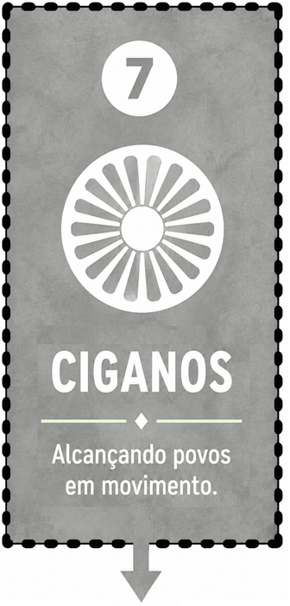

0
0
0
0
0
0
0
0

Slide 2

0
0
0
0
0
0
0
0

Slide 3

0
0
0
0
0
0
0
0

Slide 4

0
0
0
0
0
0
0
0

Slide 5

0
0
0
0
0
0
0
0

Slide 6

0
0
0
0
0
0
0
0

Slide 7

0
0
0
0
0
0
0
0

Slide 8

0
0
0
0
0
0
0
0

Slide 9

0
0
0
0
0
0
0
0

